Slide 1



Covid 19
View in Power BI
Last data refresh:
1/19/2023 4:43:54 AM UTC
Downloaded at:
3/4/2023 7:13:09 PM UTC

Slide 2
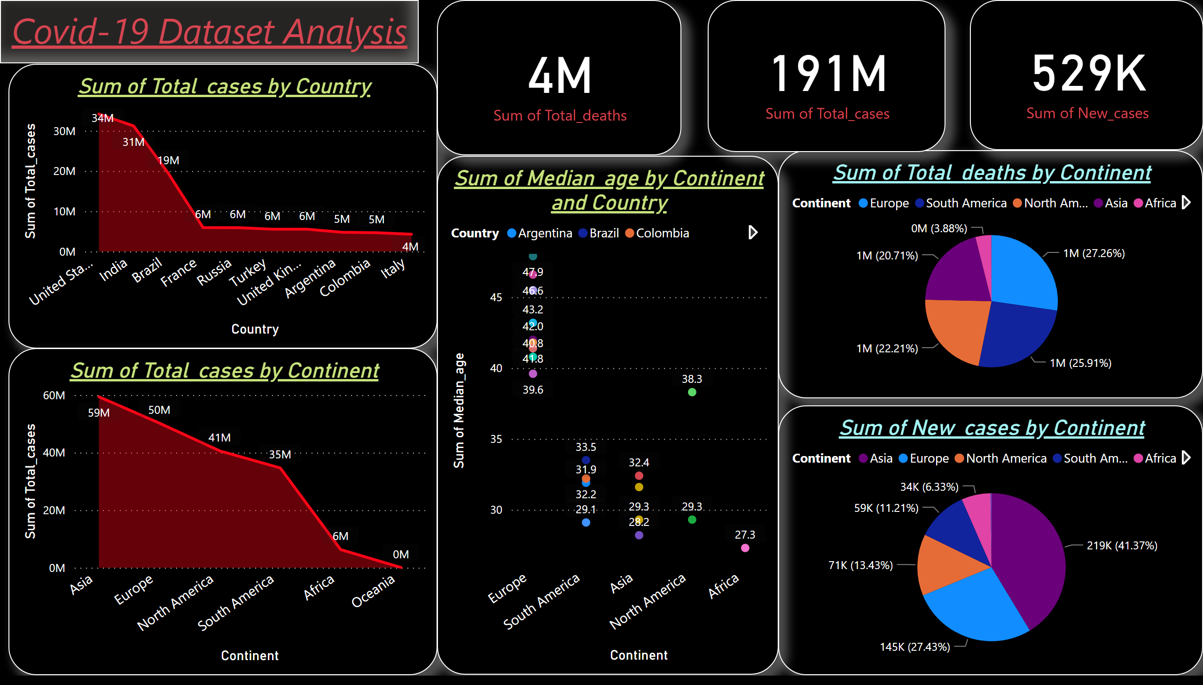
Page 1
Notes:
areaChart
No alt text provided
pieChart
No alt text provided
pieChart
No alt text provided
areaChart
No alt text provided
lineChart
No alt text provided
card
No alt text provided
card
No alt text provided
card
No alt text provided
textbox
No alt text provided

